Slide 1
International Roma Day 6 April 2016

Slide 2
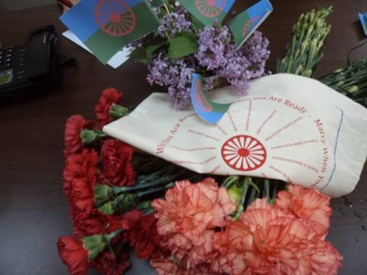

Slide 3
Isernia - Italy
Are Ready
{

Slide 4
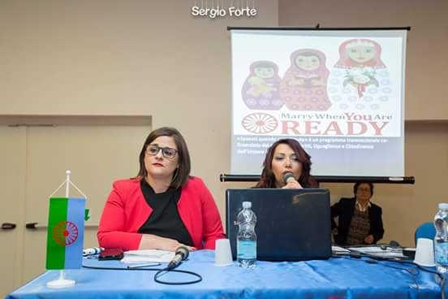
Isernia - Italy

Slide 5
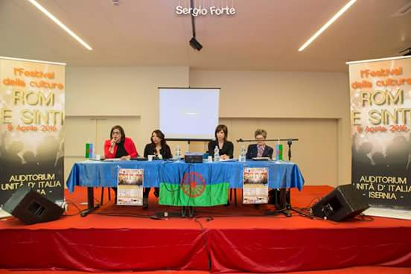
Isernia - Italy

Slide 6
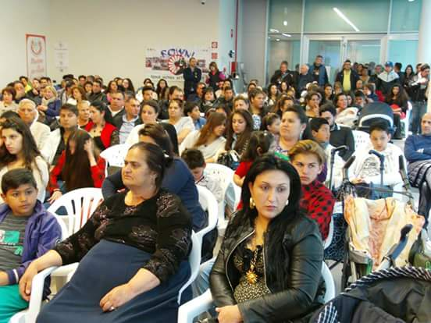
Isernia - Italy

Slide 7
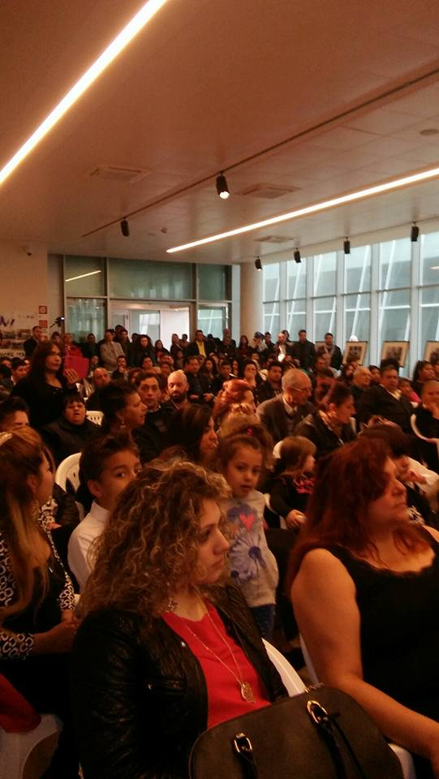
Isernia - Italy

Slide 8
Pavia- Italy

Slide 9
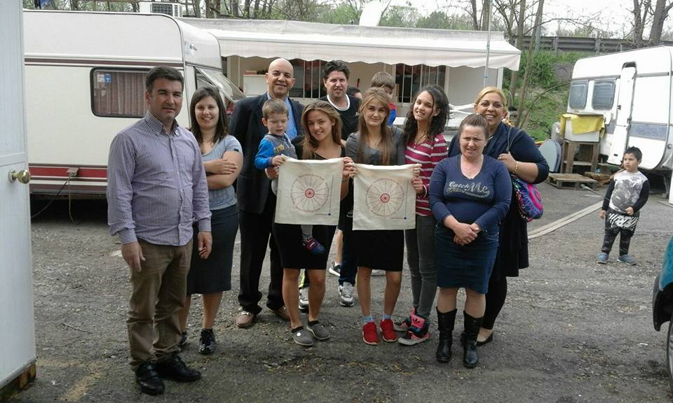
Pavia- Italy

Slide 10
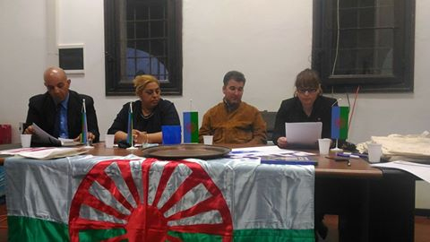
Pavia- Italy

Slide 11
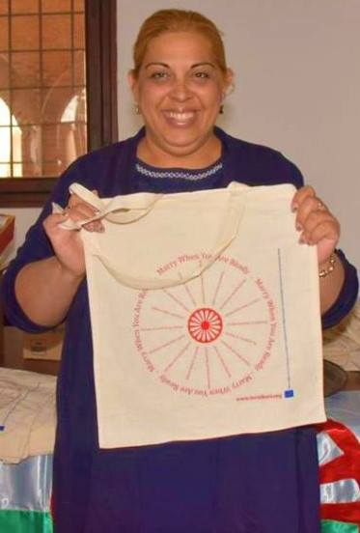
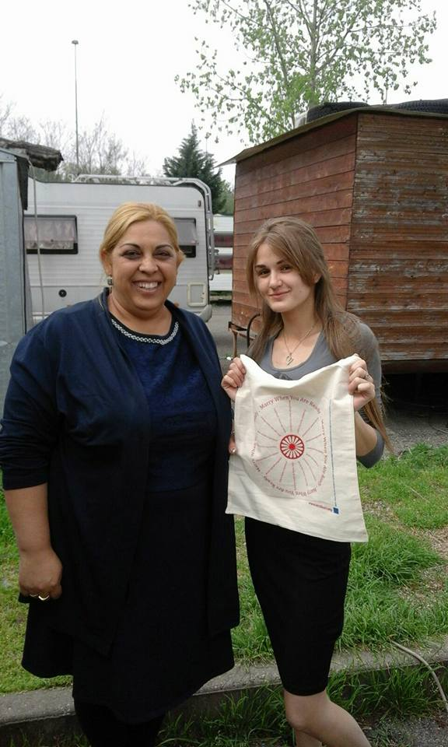
Pavia- Italy

Slide 12
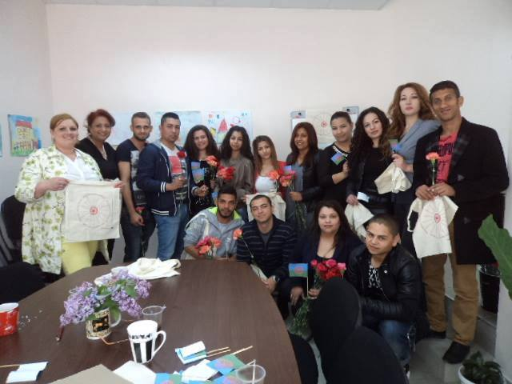
Balgoevgrad- Bulgaria

Slide 13
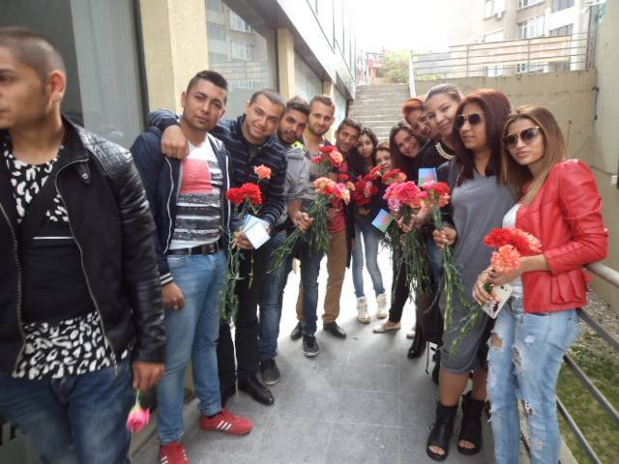
Balgoevgrad- Bulgaria

Slide 14
Contact
Web: http://www.ternibori.org
Contact: info@ternibori.org
Skype: ternibori
Support us:
https://www.facebook.com/groups/1564363080550334/?fref=ts
Like us:
https://www.facebook.com/Merry-When-You-Are-Ready-180742592302350/?fref=ts
Learn and disseminate:
https://www.youtube.com/channel/UCNL-kN_jPj9B9lOrbp853Qw

